Slide 1
MOHAMMED MUSHRAF’S
PRESENTATION

Slide 2
Digital Portfolio
STUDENT NAME: S.MOHAMMED MUSHRAF
REGISTER NO AND NMID: 5F7F23B0925BFD1A02F47A6BB87A8A15
ASUNM1301212402385
24H038
DEPARTMENT: BCA
COLLEGE/ UNIVERSITY: A.M.JAIN COLLEGE

Slide 3
PROJECT TITLE
Interactive Digital Portfolio Using Front End
Web Development

Slide 4


AGENDA
Problem Statement
Project Overview
End Users
Tools and Technologies
Portfolio design and Layout
Features and Functionality
Results and Screenshots
Conclusion
Github Link
3/21/2024 Annual Review

Slide 5

PROBLEM STATEMENT
In today's competitive digital landscape, individuals often struggle
to effectively showcase their skills, work, and personal brand online.
Without a personal portfolio, it's difficult to stand out to potential
employers, collaborators, or clients. The lack of a centralized,
visually appealing, and professional platform limits career
opportunities and personal branding.

Slide 6

PROJECT OVERVIEW
This project is a personal portfolio website me MUSHRAF, a tech innovator,
digital marketer, and creative developer. It serves as a digital identity, my
skills, past work, and contact information in a clean, modern, and mobile-
responsive format. The website uses smooth scrolling, interactive
navigation, and a "Career Finder" project to demonstrate Avenash's
capabilities and value proposition.

Slide 7

WHO ARE THE END USERS?
Recruiters and hiring managers looking to assess technical and
creative skills
Clients or businesses interested in digital marketing, automation,
or web development services
Collaborators or peers in tech/startups seeking partnerships
General audience interested in learning more about my
work and skills

Slide 8

TOOLS AND TECHNIQUES
HTML5 – Structuring the web content
CSS3 – Styling and responsive design
JavaScript – Interactivity (hamburger menu, scroll effects)
Wix – Used for hosting the featured project (Career Finder)
Fonts –
‘Poppins’ font for modern typography
Gradient and Shadow Effects – For modern visual design
Responsive Design – Media queries for mobile support

Slide 9
POTFOLIO DESIGN AND LAYOUT
Navigation Bar: Fixed at top with links to Home, About, Work, Contact, and
Skills. Includes a hamburger menu for mobile.
Hero Section: Full-screen intro with name, tagline, and call-to-action button.
About Section: Short bio and list of technical and professional skills.
Work Section: Highlight of the featured project (Career Finder), including a
button linking to a live demo.
Contact Section: Simple form to collect user inquiries.
Back-to-Top Button: Floating button for better UX on long pages.
Color Theme: Dark mode with gradients and glowing shadows for a futuristic,
tech-savvy feel.

Slide 10
FEATURES AND FUNCTIONALITY
✅ Responsive Design – Works seamlessly across desktops, tablets,
and smartphones.
✅ Hamburger Menu – Mobile-friendly navigation toggle.
✅ Smooth Scrolling – Enhanced UX for navigating between sections.
✅ Call-to-Action Buttons – Encourage users to explore work or
contact.
✅ Interactive "Career Finder" Project – Showcases a real-world
solution.
✅ Contact Form – Collects messages from visitors.
✅ Scroll-based Back-to-Top Button – Improves navigation experience.

Slide 11
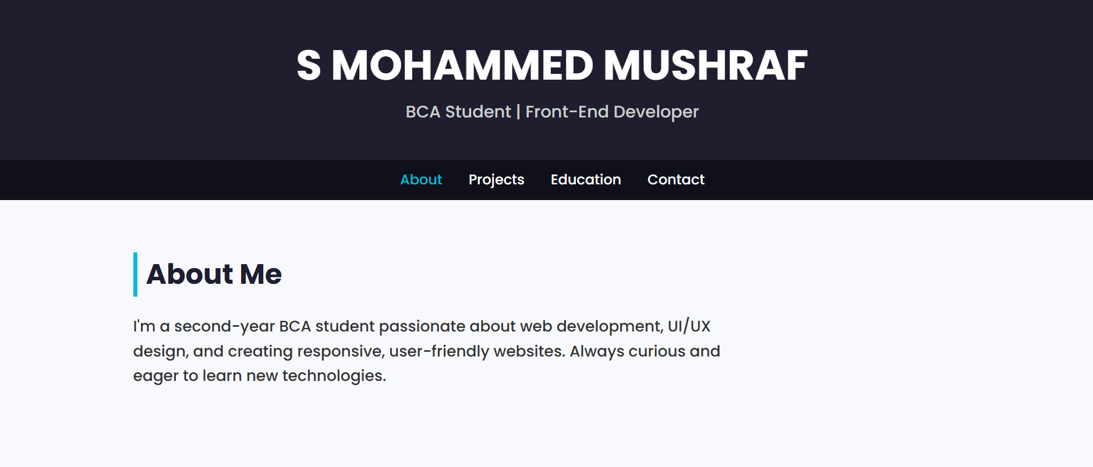
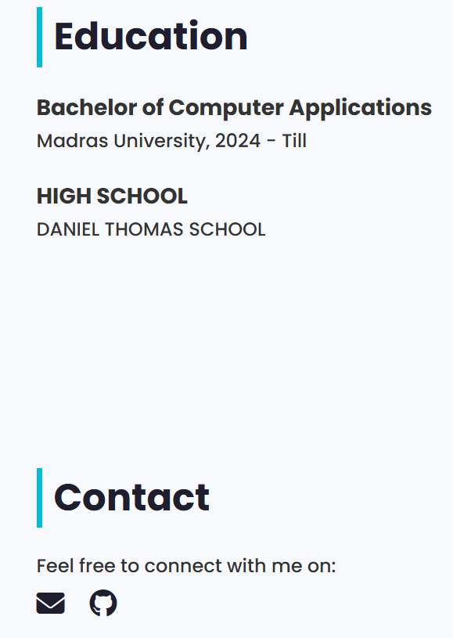

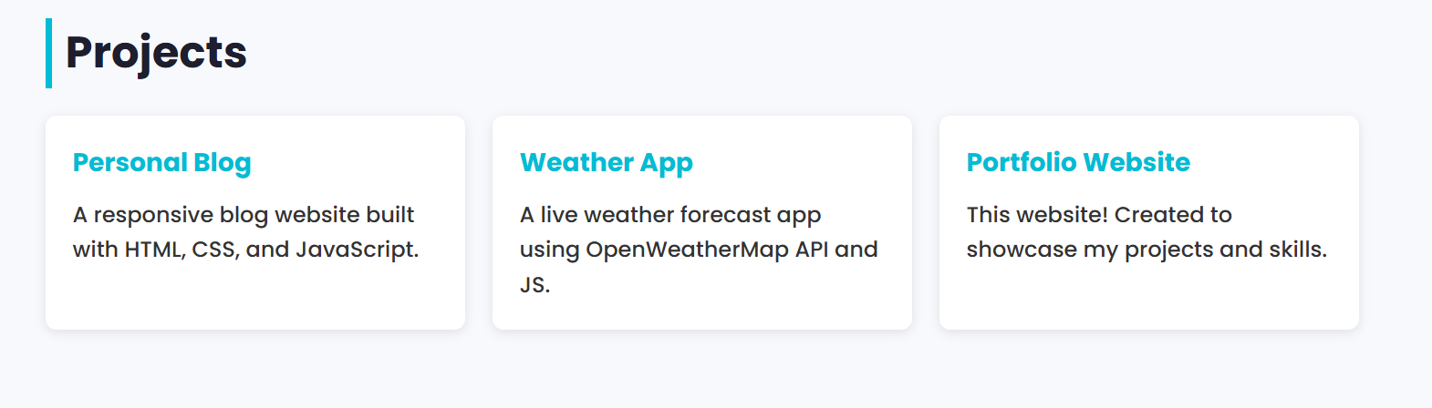
RESULTS AND SCREENSHOTS
3/21/2024 Annual Review

Slide 12
CONCLUSION
This personal portfolio project effectively showcases my skills,
creativity, and professional experience in a visually engaging
and user-friendly manner. With a clean layout, responsive
design, and interactive features like smooth scrolling and a
mobile-friendly menu, it serves as a powerful digital identity. By
highlighting key strengths and a featured project, it not only
builds personal branding but also opens doors to career
opportunities, collaborations, and client engagements.

Slide 13

Github Link:
https://github.com/24h038-cell/webdemo.git

